Slide 1

SOMETHING NEW UNDER THE SUN?
THE RESEARCH PROPOSAL
PESGB PRE-CONFERENCE
NEW COLLEGE, OXFORD
29th MARCH, 2019
Diana Murdoch
University of Edinburgh

Slide 2

My former life….
Would you exchange this ......

Slide 3
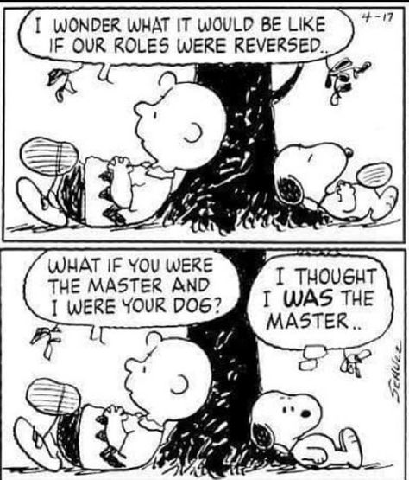
… for this.....

Slide 4
Six questions to ask yourself, when planning a research proposal
What do I want to research?
Where does my idea fit with current thinking, research, policy or practice?
Why do I want to research this?
How could I do the research?
What difference will this research make?
Who will care if this research is done?
Notes:
Click to add each question

Slide 5

Question 1: What do I want to research?
Did I have a brilliant idea?
NO!
Working from a broad idea to a more narrow and focused topic to research.

Slide 6
Original proposed topic (2014):
A small-scale qualitative study of the experiences of inclusion and exclusion of a number of young people, their families and their teachers, in the late primary and early secondary years in Scottish schools.
Final thesis title (2018):
Lived experience and inclusive education: An exploration of the phenomenon of inclusive education in the life world of young people, parents and teachers.

Slide 7
2. Where does my idea fit with current thinking, research, policy or practice?
Read around the topic
Find background and context
Read other research
Give current debates and all sides of the argument
One method: Snowball approach:
  Break your research down into topic areas.
  Research one topic in one peer-reviewed journal
  Use references to identify other papers in that journal or in similar journals
  Find the big names
  Look at ‘high use’ books in the library
  Talk to other people, attend conferences, use different media.
  Repeat for other relevant topics, to build up a picture.

Slide 8
Finding the gap
Not usually immediately obvious.
May emerge gradually.
Consider a new approach or angle on a familiar area or topic.
Look at the recommendations for further research topics in papers, across multiple unrelated studies, to find repeated similarities.
Once you think you have identified a gap in the literature, do a detailed search on that topic.

Slide 9
Formulating the research question(s)
Decide exactly what it is you want to research.
Gradually narrow down the topics.
Identify your research aims.
Use clear and accurate wording.
Initial questions can be changed and improved later.
More than one question is acceptable.
The question(s) should lead to your research.

Slide 10
My research questions
2014
What are the aspects of inclusive and special education, which most affect young people, their families/carers and their teachers?
Do young people and their families/carers feel included in the education process and if so, in what ways?
Do the policies of inclusion and exclusion have negative and positive consequences on the lives of some young people their families/carers and their teachers?
2018
How do young people with additional needs, their families and their teachers, experience inclusive education in a Scottish secondary school ?

Slide 11
3. Why do I want to research this topic?
Motivation and aims
Personal motivation
Professional motivation
Academic motivation
Funding motivation
Interesting and challenging topic
Desire to make a difference
Important to bring something to light
Important to further my career
For a career change
To enhance my knowledge
Desire or invitation to work as part of a specific research team.
Work with a potential supervisor.
Response to a funding opportunity from employer or business.

Slide 12
4. How could I do the research?
Practical considerations
Academic
Personal life
Professional life
Family circumstances
Proximity to a university
Location and manner of research
Finance: Sources of funding
Loss of income
Increased costs/expenses of research, travel, books, conferences(!)
Pension implications
Methodology:
  What is the philosophical basis to the research?
Methods:
  How will your chosen methods allow you to fulfil your research aims and answer your research questions?
  Feasibility: Indicate in your proposal a detailed timeline for your whole project.

Slide 13
Methodology
Include an overview of methodologies, to indicate that you have come to a clear and reasoned decision about your choice.
Read extensively to gain a sound conceptual understanding of research in your area.
Address issues of truth, validity, bias and ethical considerations.
Methods
Must fit with your chosen methodology.
Consider the practical implications of different methods.
Read accounts of research using similar approaches.
Note the limitations and difficulties encountered by others.
Limitations with human subjects include access, vulnerability, gatekeepers, time etc.
Suitability of your method for addressing your research question and aims.
Include in your proposal a detailed timeline for the whole research project.

Slide 14
Everything takes longer than you think!
Talk to others, and be realistic about what you can achieve alongside all your other commitments.
Think about the time it will take to do research with people, who, with the best will in the world may be busy, disinterested, forgetful or just plain difficult!
Conceptual or desk-based research sounds more straightforward from this point of view, but others say that the sheer volume of available information can be overwhelming and they long for a bit of the real world, from time to time.
Let’s face it: nothing’s easy!

Slide 15
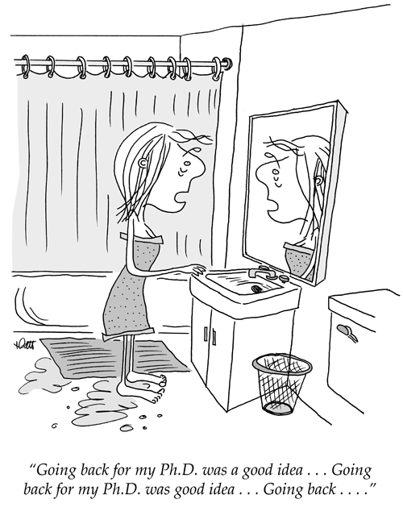

Slide 16
5 and 6 : The ‘so-what’ questions
What difference will my research make?
Who will care if this research is done?
Difficult to know this.
Think again about your motivation and aims.
You thought it was worthwhile, and you were clear about your reasons.
Will you present something in a new or different way?
Will you do research with a group of people not often heard in research?
Might you throw light on an area of knowledge which was confused or overlooked?
Will you synthesise other research findings?
Who might benefit from your findings?
In other words, will it have an impact?
Never lose sight of the so-what question.
It will keep you grounded!

Slide 17

Above all, enjoy the fantastic opportunity you have!

Slide 18
Diana Murdoch
Moray House School of Education,
University of Edinburgh
Holyrood Road,
Edinburgh
EH8 9JX
Diana.Murdoch@ed.ac.uk
Research interests: Inclusive and special education, inclusive pedagogy, dialogic teaching, phenomenology, Levinas, Merleau-Ponty, listening and silence in education.

