Slide 1

Starting a PhD
Sarah Smith
sbeard1@stu.chi.ac.uk
University of Chichester
University of Bristol
@Sarah_E_Smith_

Slide 2

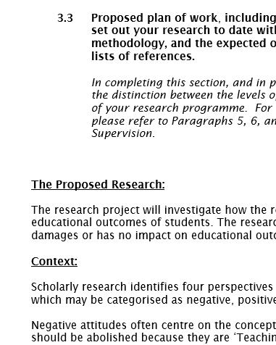

Starting a PhD
Research proposal
Tips for starting a PhD
This Photo by Unknown Author is licensed under CC BY-NC

Slide 3

Research Proposal
Title from Form 1:
An investigation into the impact of faith based identity on a school’s educational outcomes
This Photo by Unknown Author is licensed under CC BY-SA-NC
Title now:
An investigation into the implicit and explicit religious identity of state-funded schools

Slide 4
Research Proposal: What is it?
Proposed plan of work, including its relationship to previous work, with references. Please set out your research to date with key references, how the stated aims will be achieved, the methodology, and the expected outcomes. Please do not exceed 750 words, excluding any lists of references.
University of Chichester Form 1, 2013/14

Slide 5
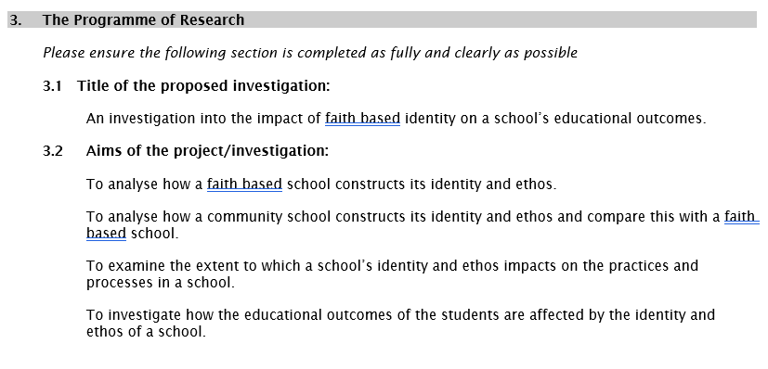

Title and Aims

Slide 6

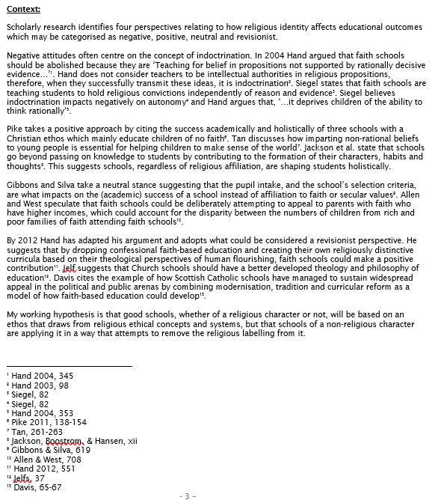
Literature Review
Key element
Challenging in a limited word count
How does the literature relate to your questions/aims?
Where does your project fit?
Hypothesis

Slide 7
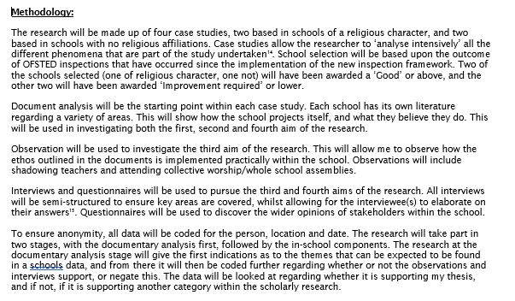
Methodology

Slide 8
Other things
Ethical approval
Timeline of events

Slide 9

Tips for Starting a PhD
Read the handbook and plan ahead
Take advantage of opportunities offered to you
Take care of yourself
Maintain and build support networks
Things may not go according to (the original) plan
Enjoy it!

